Slide 1
ORM (object-relational mapping)
Presentation
Proj-25-Istishara

Slide 2
Overview
In this presentation we will get to learn about Jaguar as an ORM (Object-relational mapping) tool, its uses and some examples we will use to help with our own project Istishara Application using Flutter.
Notes:
As we are still taking baby steps concerning the next phase of database modeling for our application. However, we will definitely get to that, use jaguar or any tool we favored and do a great job.

Slide 3
Jaguar ORM for Dart
Jaguar is an Open-source Project for Source-Generated and statically-typed ORM with relations such as 1-to-1, 1-to-many, many-to-many, preloading, cascading, polymorphic relations...etc . It is a batteries included, full-stack production ready HTTP server framework that is simple, fast and extensible. It also offers a convenient way to write SQL queries
Notes:
We tried looking for an ORM that would work well with Flutter as to not use any time in researching another.
I have made some tests including the sqlEntity which employs scaffolding concepts and it's does more stuffs like forms than just data persistence. For me seems like Floor is more close to Hibernate mainly in the way that Entities were created, just make a comparison between their Entities sintaxe, therefore I found it more familiar and have choose Floor despite it's very new yet.
Also there is Jaguar ORM for Dart: https://github.com/Jaguar-dart/jaguar_orm. I haven't tested JaguarORM yet, but it's the only one that have support for OneToOne, OneToMany, and ManyToMany relationships and it's also support other databases.
Moor has an experimental support for the web, take a look: https://moor.simonbinder.eu/web/. Despite it's an experimental feature, if your app will need to be portable the web, you need to consider it. There is another alternative for the web: https://github.com/sql-js/sql.js. The fact is it's very difficult allow sqlite be abstracted to local storage in browser. But at least Moor is trying to achieve it.
For those that are looking to DateTime converters both Floor and Moor already support it. Floor added it since version 0.17: https://github.com/vitusortner/floor#type-converters

Slide 4

Jaguar ORM for Dart overview
Jaguar documentation to get familiar with its uses and capabilities.
Notes:
https://www.reddit.com/r/FlutterDev/comments/k0406n/automatically_generate_the_code_needed_for_json/
JaguarReadMe file available in the folder as well

Slide 5
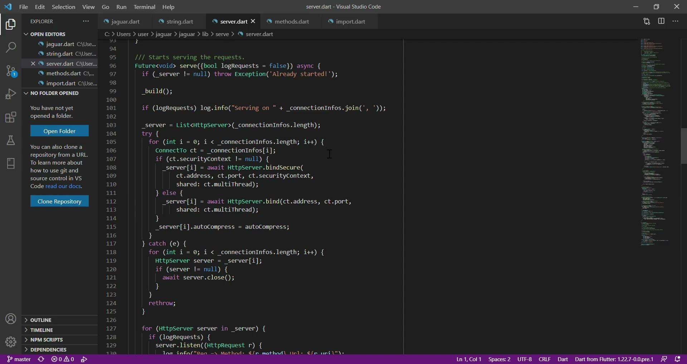
Jaguar ORM for Dart overview
Jaguar main files .dart to import/use while working with Flutter on our application.
Notes:
Helpful tool added: Automatically generate the code needed for json_serializable and jaguar_serializer and automatically run the flutter pub run build_runner build -delete-conflicting-outputs command. Makes developing flutter even easier! : FlutterDev
JaguarReadMe file available in the folder as well

